Slide 1
Introduction to Single Crystal Inelastic Neutron Scattering and Horace
Notes:
1

Slide 2
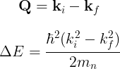
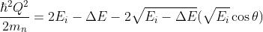

Recap
Conservation of momentum
And energy
Recap from yesterday:
Detector trajectories:
(Powder)
(Single Crystal)
-
+
k_{f}
k_{i}
Q
k_{i}
Direct geometry

Slide 3
Recap
Conservation of momentum
And energy
Recap from yesterday:
Detector trajectories:
(Powder)
(Single Crystal)
-
+
k_{f}
Q
k_{i}
k_{i}
Direct geometry

Slide 4
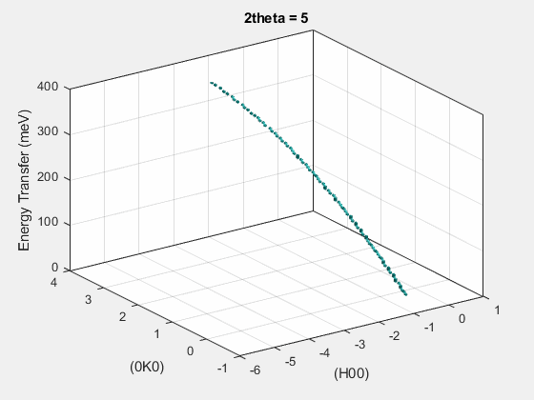
Recap
Conservation of momentum
And energy
Recap from yesterday:
Detector trajectories:
(Powder)
(Single Crystal)
-
+
Direct geometry

Slide 5
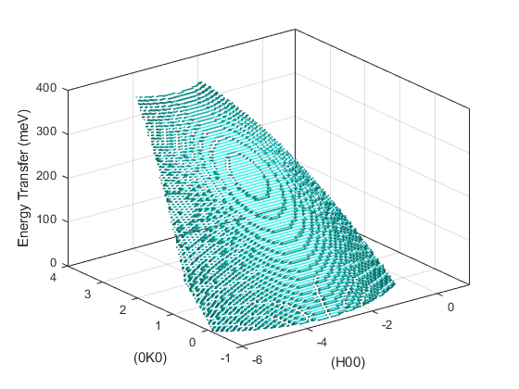
Detector Trajectories
So, each detector (at specified angular position w.r.t. sample) traces a parabolic line through (Q,ω)-space.
Taken together, a bank of detectors traces a parabolic surface in (Q,ω)-space:

Slide 6
Sample Rotation
What happens when we rotate the sample?
Recap: rotating the sample (lattice) is equivalent to rotating the scattering triangle:
Q
k_{f}
k_{i}
k_{i}

Slide 7
Sample Rotation
What happens when we rotate the sample?
Recap: rotating the sample (lattice) is equivalent to rotating the scattering triangle:
Q
k_{f}
k_{i}
k_{i}

Slide 8
Sample Rotation
What happens when we rotate the sample?
Recap: rotating the sample (lattice) is equivalent to rotating the scattering triangle:
→ In a single crystal, rotating the sample is equivalent to rotating the detector surface in (Q,ω)-space
Q
k_{f}
k_{i}
k_{i}

Slide 9
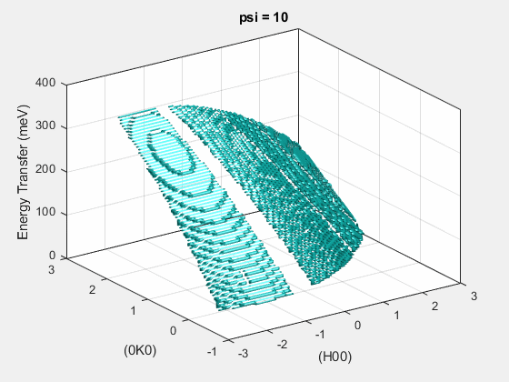
Sample Rotation
In a single crystal, rotating the sample is equivalent to rotating the detector surface in (Q,ω)-space

Slide 10
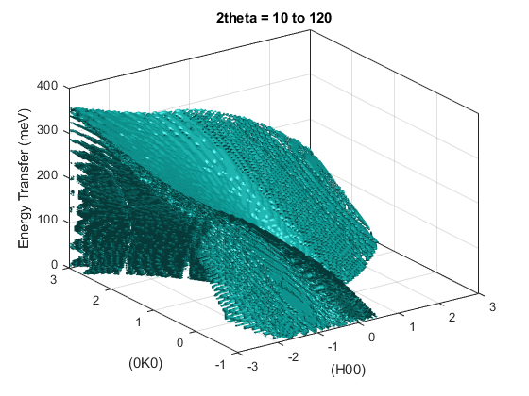
Sample Rotation
By rotating the sample by small angles, we can combine the different detector surfaces cutting through (Q,ω)-space into a single 4D dataset.
This is what Horace does.

Slide 11
Questions so far?

Slide 12
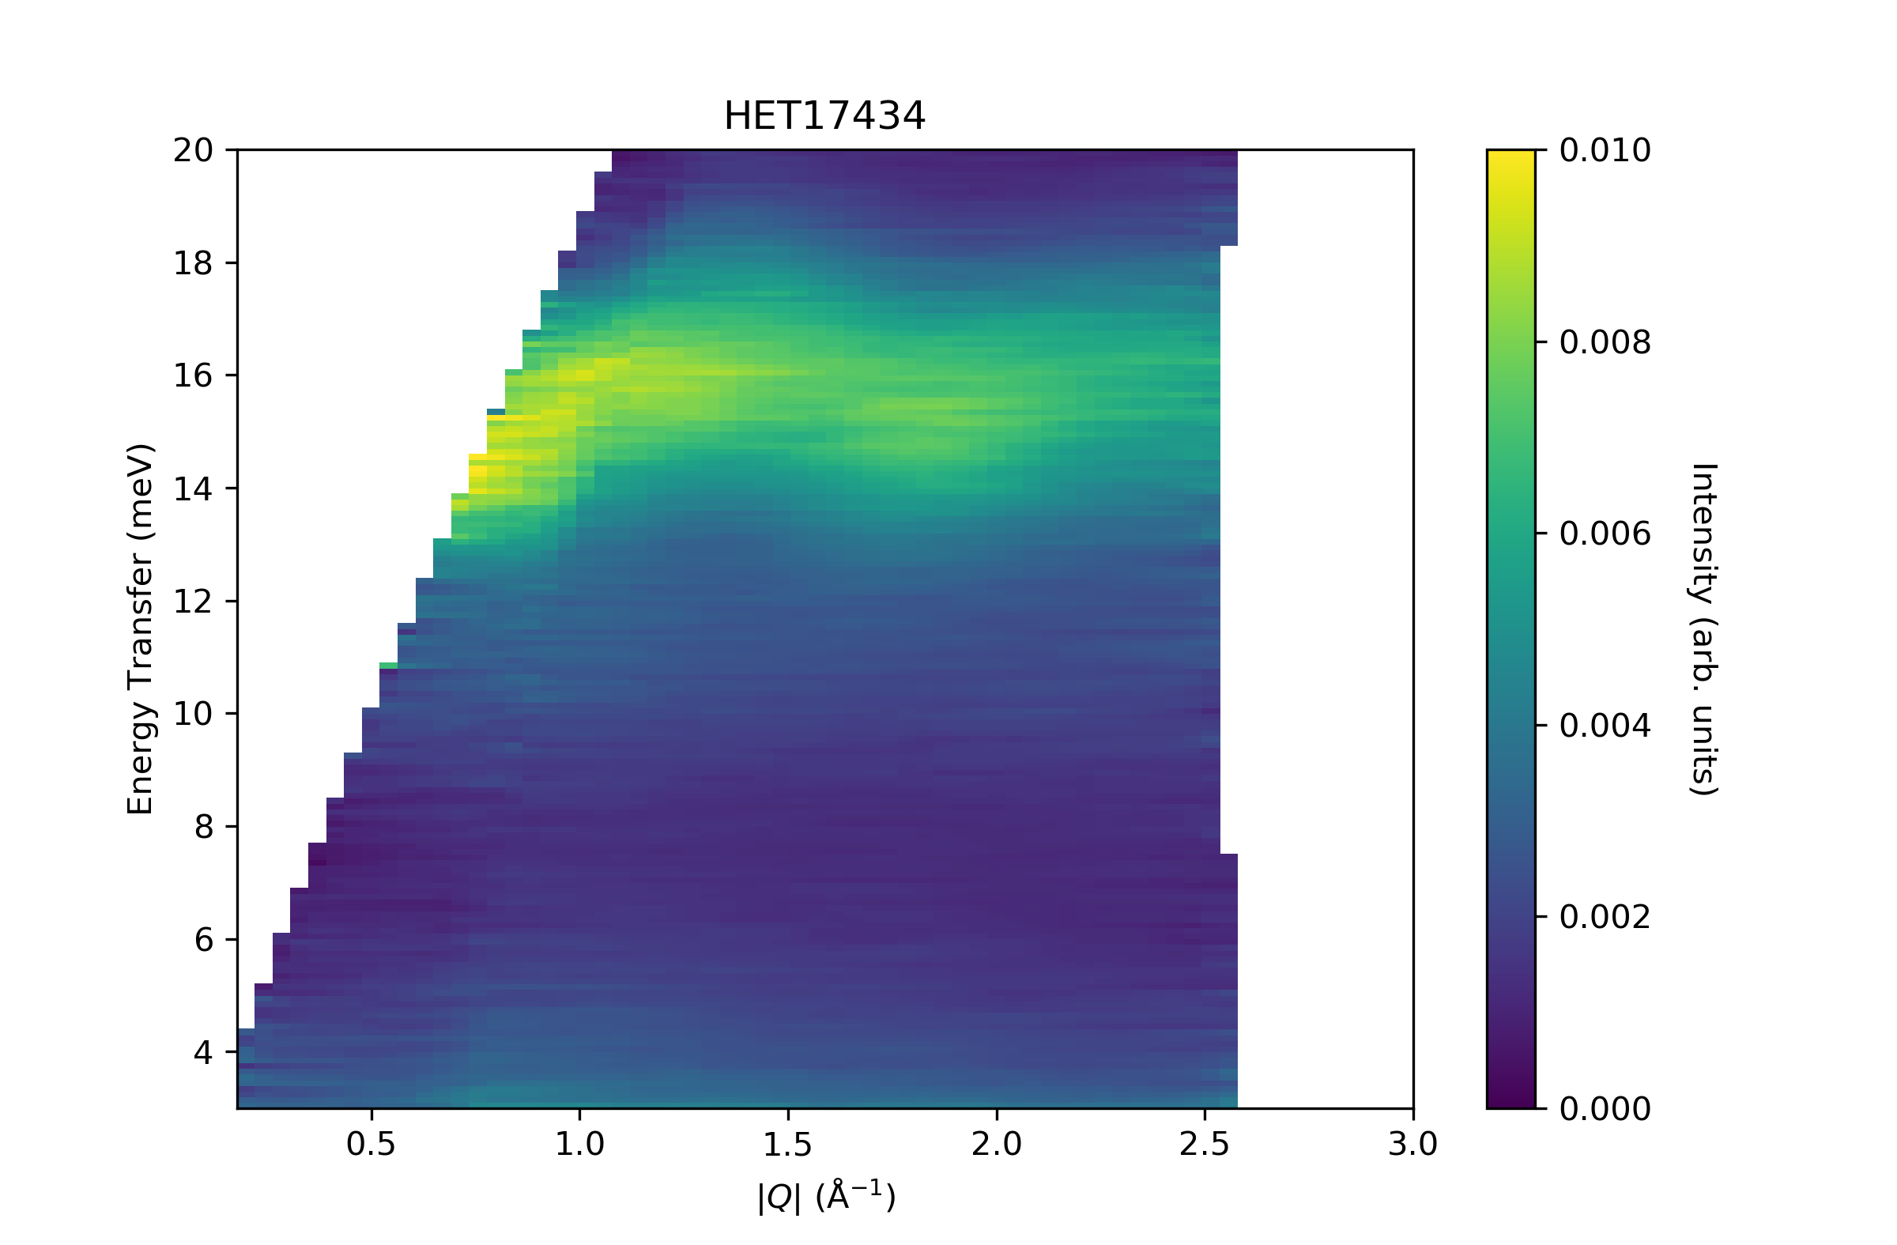
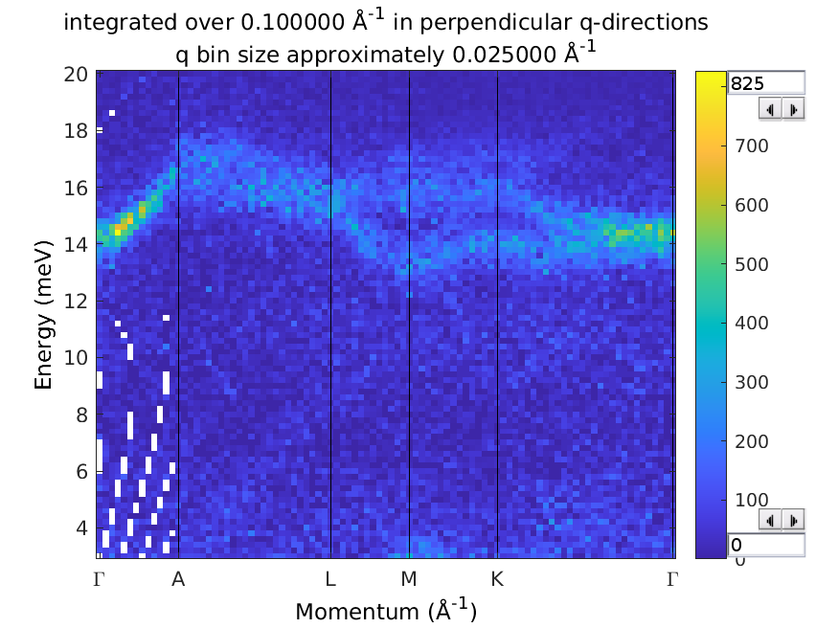
Single Crystal INS
Why measure excitations in single crystals?
In powder (polycrystalline) measurements can only measure the magnitude of momentum transfer |Q|
Directional information is lost.
With single crystal, can see the full dispersion surfaces ω(Q)
UPd₃
Notes:
12
Inelastic neutron scattering measures

Slide 13
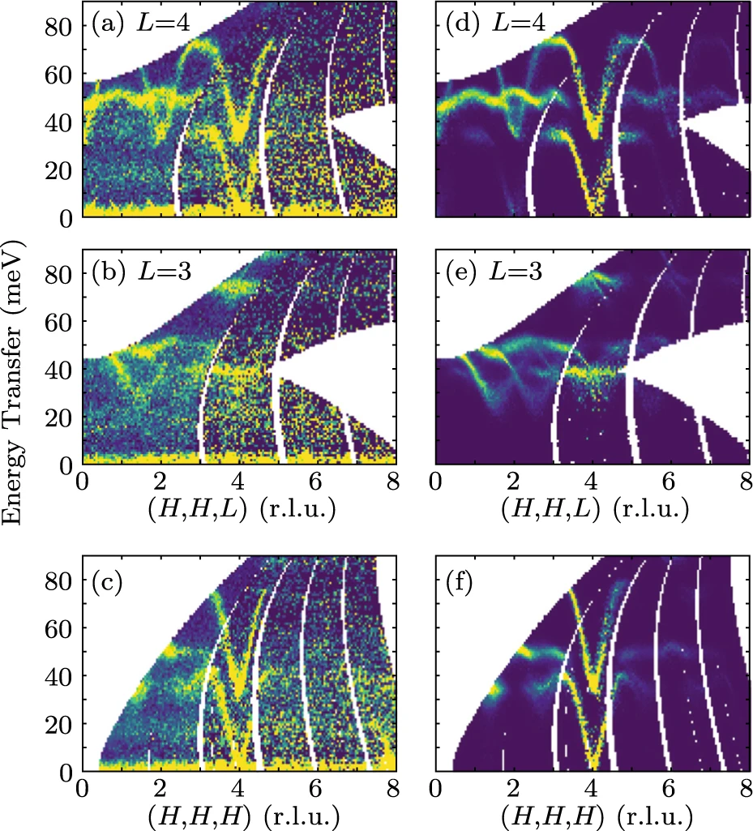
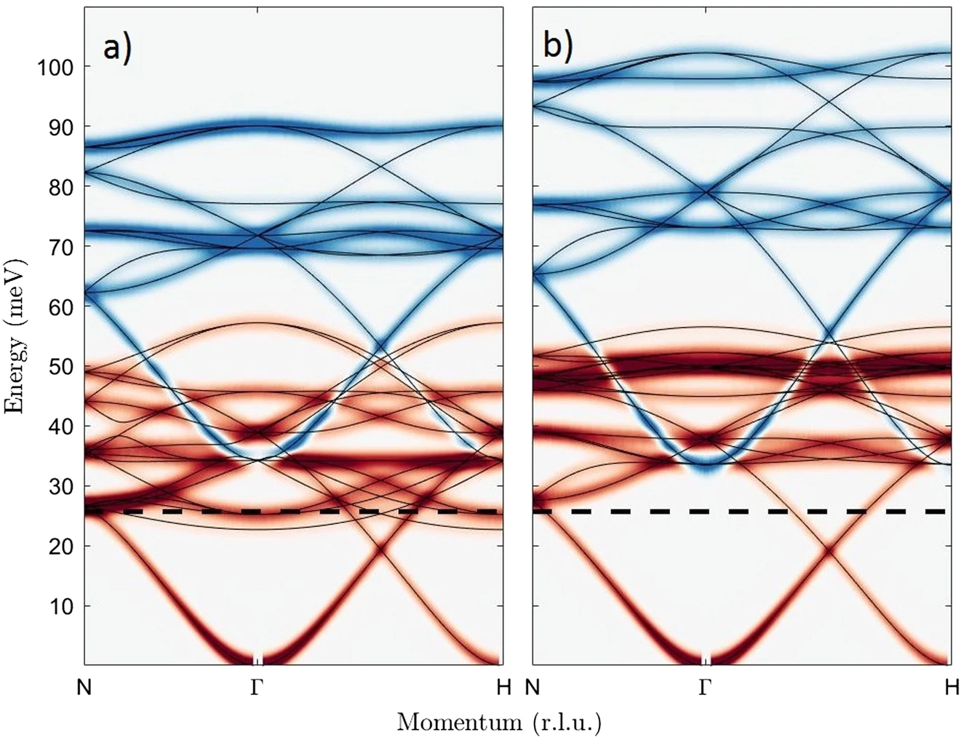
Single Crystal INS
The advantage of direct-geometry ToF spectrometers is the large Q-coverage – can measure several full Brillouin zones.
This allows e.g. a very detailed look at the dispersion giving much more accurate exchange parameters.
Old Model
New Model
Yttrium Iron Garnet, Princep et al., npj Q. Mater., 2 (2017) 63
Notes:
13
Inelastic neutron scattering measures

Slide 14
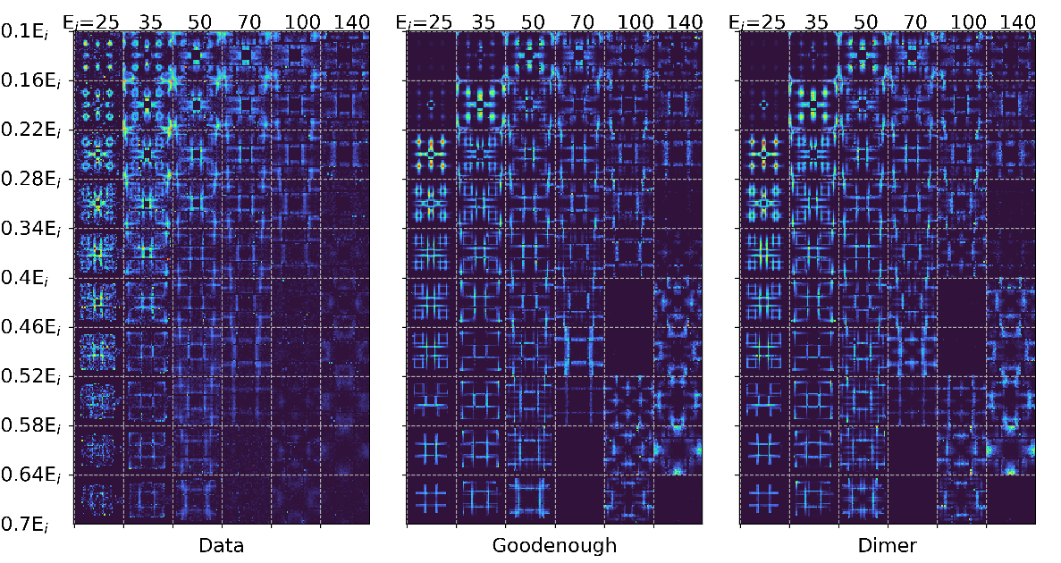
Single Crystal INS
Or the large Q-coverage can allow you find a particular small region in Q-space which distinguishes between two models, which is not a priori obvious.
Pr(Ca,Sr)Mn₂O₇, Butler et al., J. Phys.: Condens. Matter, 33 (2021) 194006
Johnstone et al., Phys. Rev. Lett., 109 (2012) 237202
Notes:
14
Inelastic neutron scattering measures

Slide 15
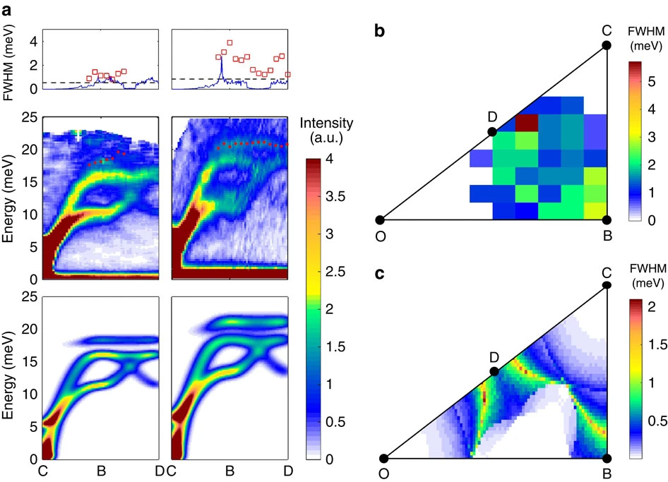
Single Crystal INS
Finally, the large Q-coverage is useful if you want to measure diffuse inelastic scattering.
Data
Model
Magnon lifetime broadening in (Y,Lu)MnO₃, Oh et al., Nat. Comm., 7 (2016) 13146
Notes:
15
Inelastic neutron scattering measures

Slide 16
Single Crystal INS
In contrast, there are some situations where you don’t need to use a direct-ToF spectrometer with large Q-coverage or full rotation scan
When you want to focus on a specific Q,ω region and want to measure a change with T, P, H, etc. → use a triple-axis spectrometer
If you have a low-dimensional magnetic material where the dispersion is only along one (or two) directions – choosing the right fixed orientation of the detector surface can be enough.
Notes:
16
Inelastic neutron scattering measures

Slide 17
Questions so far?

Slide 18
Horace
Horace is used for 3 main tasks:
Creating a 4D S(Q,ω) dataset (an “.sqw” file) from a set of runs at different sample rotation angles
Viewing / plotting this data in particular (Q,ω) regions
Fitting the data (either using a model for the scattering or to simple peak functions)
Horace is mostly a command-line driven program in Matlab.
There is a GUI which can do all of these tasks, but represents only about ≈70% of the functionality of Horace.
The next sections will give an overview of how the program works and what it can do
Ewings et al., Nucl. Inst. Meth. Phys. Res. A, 834 (2016) 132

Slide 19
Generating the 4D sqw file
The data stored in the 4D sqw file is stored in chunks in a coarse regular grid in (Q,ω)-space.
This allows fast access when you want to view a specific (Q,ω) region (just that chunk needs to be read).
But it means that Horace needs to know the full angular range of a scan in order to determine the (Q,ω)-grid.
(e.g. you have to give the full ψ rotation range when you generate the sqw file)
Horace is designed to run in parallel on both shared memory systems and clusters but it can also run on your laptop!
The bottleneck is usually disk-access speeds
Ewings et al., Nucl. Inst. Meth. Phys. Res. A, 834 (2016) 132

Slide 20
Generating the 4D sqw file
To generate the 4D sqw file, you need to give Horace:
The lattice parameters
The incident energy E_{i}
The crystal orientation
Specified as 2 vectors: u and v which define the horizontal plane
A set of angles ψ (psi) where ψ=0 corresponds to u||k_{i}. (u parallel to the incident beam), corresponding to all the measurements made (or planned).
Offset angles (dψ [dpsi], Ω [omega], GU, GL) denoting crystal mis-alignments.
GU
u
Ω
n
ψ
GL
v
Ewings et al., Nucl. Inst. Meth. Phys. Res. A, 834 (2016) 132

Slide 21
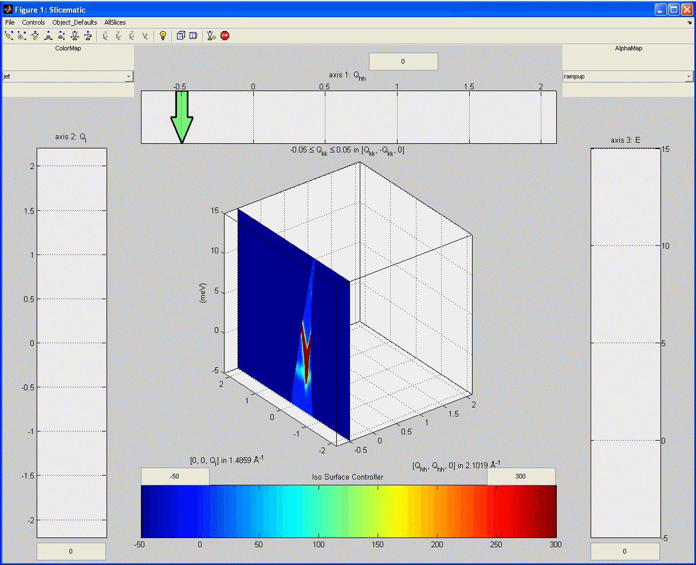

View data
Horace can plot 1D, 2D, 3D sections (“cuts”) of the data:
RbMnF₃, Ewings et al., Nucl. Inst. Meth. Phys. Res. A, 834 (2016) 132

Slide 22
View data
Horace can plot 1D, 2D, 3D sections (“cuts”) of the data:
ε = 6 meV
RbMnF₃, Ewings et al., Nucl. Inst. Meth. Phys. Res. A, 834 (2016) 132

Slide 23
Horace Data Types
When you use Horace to take a section from the sqw file (“make a cut”) you can create two types of objects:
dnd (d1d, d2d, d3d, d4d) objects contain only histogrammed (binned) data
sqw objects contains both histogrammed data which can be plotted and all the detector-energy elements (“pixels”) which were rebinned.
sqw objects are created by default but take up a lot of memory.
dnd objects are created with the '-nopix' flag.
Certain operations (smooth, replicate) only work with dnd objects
Other operations (resolution convolution, symmetrisation, re-rebin) only work with sqw objects
Ewings et al., Nucl. Inst. Meth. Phys. Res. A, 834 (2016) 132

Slide 24
Questions so far?
(and 5 min break)

Slide 25
Horace GUI Demonstration
Horace GUI Demonstration

Slide 26
Summary
For a given single crystal sample orientation (rotation angle), the detector banks on a direct-geometry ToF spectrometer image a 3D parabolic surface in the 4D (Q,ω) reciprocal space.
This surface changes when the crystal is rotated.
By combining multiple measurements at different rotations, a 4D S(Q,ω) dataset (an .sqw file for Horace) can be reconstructed.
These single-crystal datasets covering large (Q,ω) are useful to details of microscopic models or explore lifetime (linewidth broadening) effects.

Slide 27
Summary
Horace stores data in the sqw file sorted in a coarse regular (Q,ω) grid for fast access.
Horace has two types of data objects in memory:
dnd (d1d, d2d, d3d, d4d) objects contain only histogrammed (binned) data. Created with the '-nopix' flag.
sqw objects contains both histogrammed data which can be plotted and all the pixels which were used in the histogrammed data.

